Slide 1

Intensive Program- 2020
Biology for Technology
Cell Biology
Dr. Priyanga Kariyawasam
Dept. of Agricultural Technology

Slide 2
Cellular Organelles & Functions
Please watch the short video on cell structure and functions
https://www.youtube.com/watch?v=HBvfBB_oSTc

Slide 3
1. Cytoskeleton
A network of fibers composed of proteins
contained within a cell's cytoplasm.
a dynamic structure
found in all cells of all domains of life (archaea, bacteria, eukaryotes)
The structure, function and dynamic behavior of the cytoskeleton could vary.

Slide 4
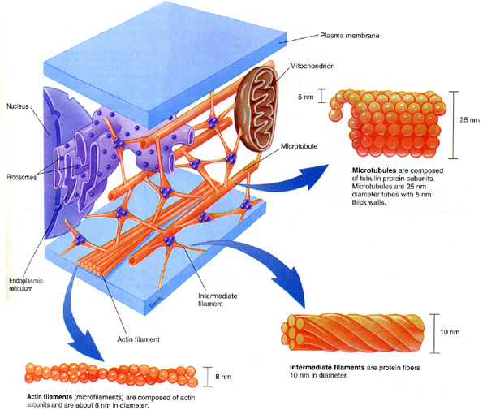
Cytoskeleton

Slide 5
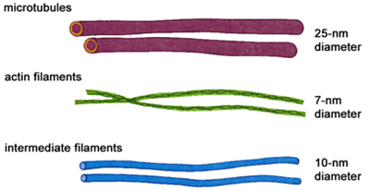
Cytoskeleton of eukaryotes has three major components.
microfilaments (made of the protein actin)
microtubules (made of the protein tubulin)
intermediate filaments, (more than 60 different building blocks/ proteins)

Slide 6
Cytoskeleton type | Diameter (nm) | Structure | Subunit examples
Microfilaments | 7 | double helix | actin
Intermediate filaments | 10 | two anti-parallel helices | Vimentin neurofilament keratins nuclear lamins
Microtubules | 25 | Proto-filaments, in turn consisting of tubulin subunits | α- and β-tubulin

Slide 7
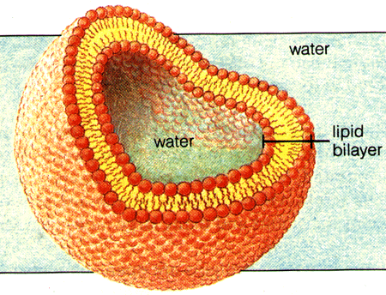
2. Cell membrane

Slide 8
Cell membrane (Plasma membrane or Cyto-plasmic Membrane)
Biological membrane that separates the interior of all cells from the outside environment
Selectively permeable to ions and organic molecules
Controls the movement of substances in and out of cells
Basic function is to protect the cell from its surroundings
Involved in a variety of cellular processes such as
cell adhesion,
ion conductivity
cell signaling
Provide a surface for attachment of extracellular and intracellular structures

Slide 9
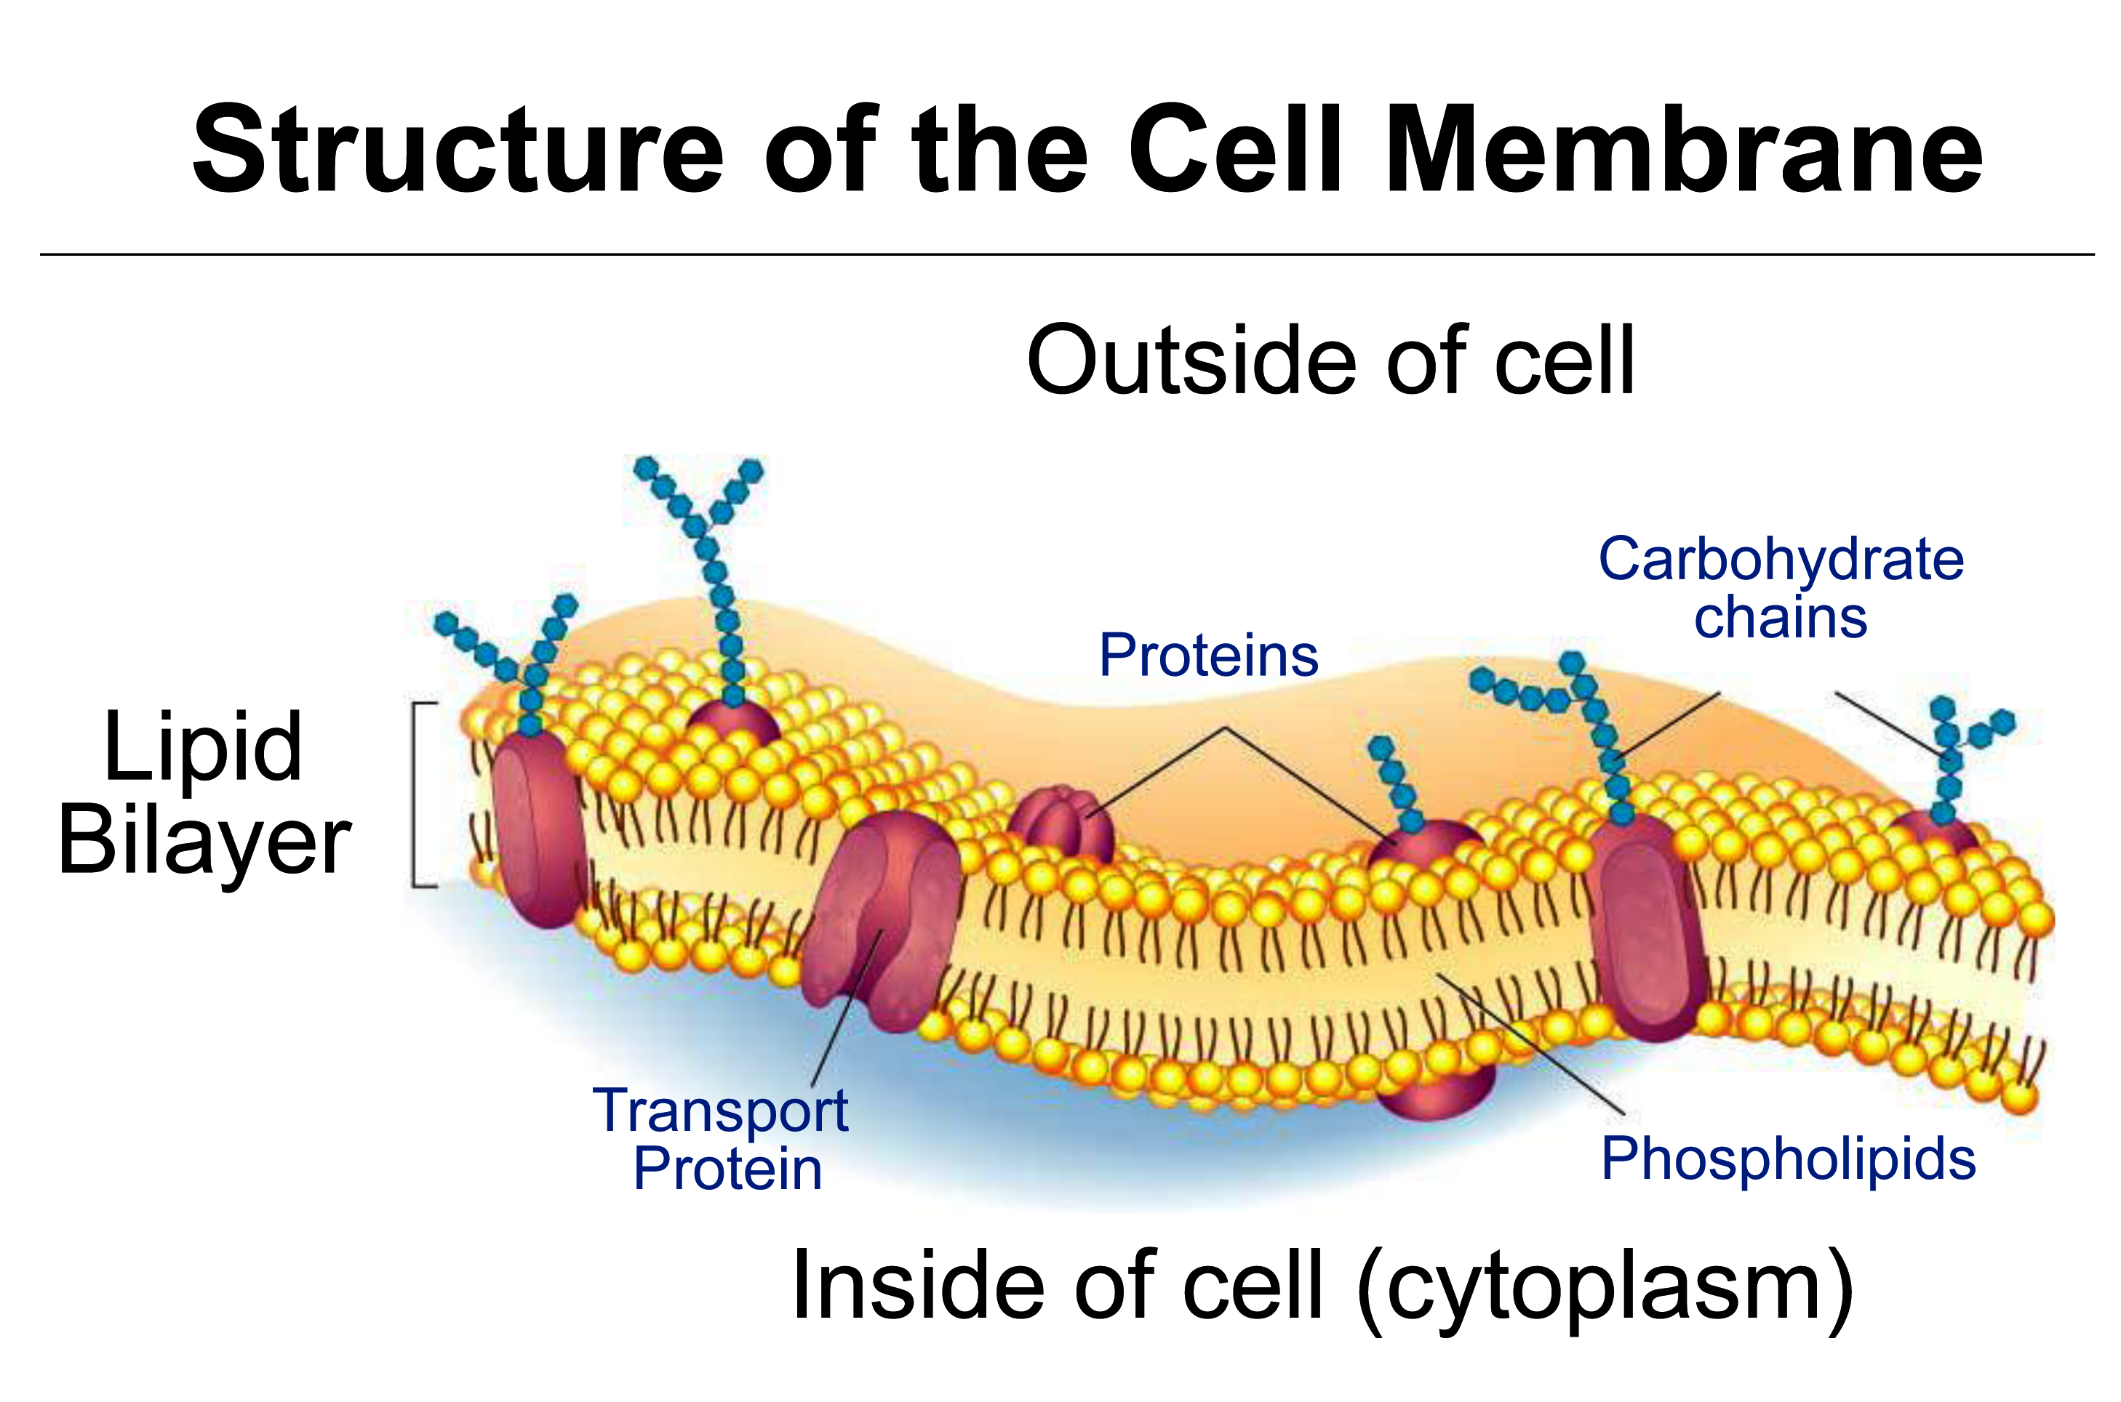

Slide 10
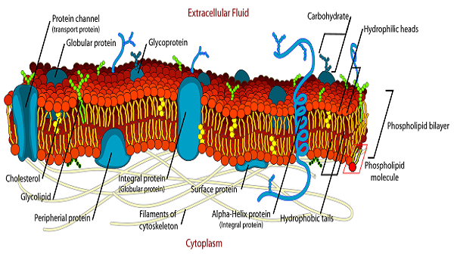

Slide 11
Fluid mosaic model Singer and Nicolson 1972
Describes the plasma membrane of animal cells
Plasma membrane has two layers (bi-layer)
Bi-layer is made by phospholipids (fats with phosphorous)

Slide 12
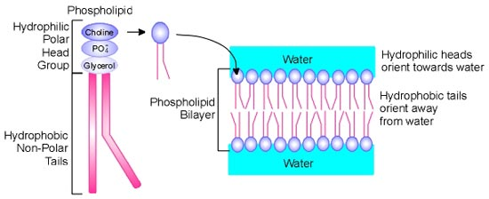
Phospholipid molecule has a head that is attracted to water (hydrophilic)
A tail that repels water (hydrophobic)
Hydrophilic heads pointed toward the outside;
The hydrophobic tails form the inside of the bilayer.

Slide 13
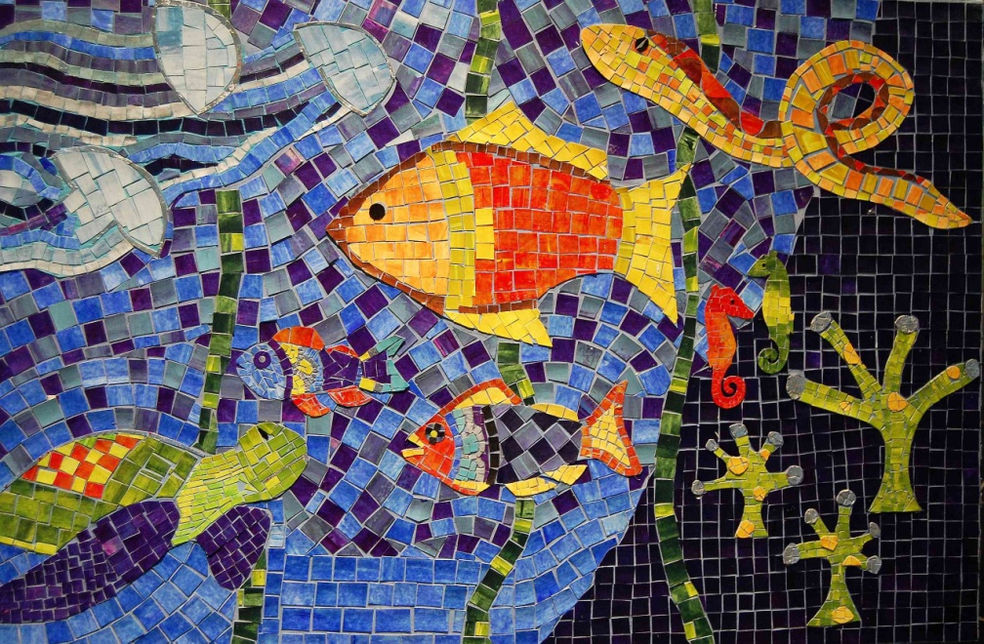
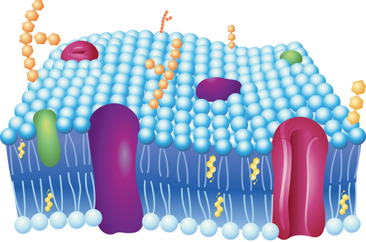
Substances such as proteins & cholesterol are embedded in the bilayer, give the membrane a mosaic look.

Slide 14
Freeze-fracture studies of the plasma membrane
Freeze the cell
Frozen membrane split along the middle of the phospholipid bilayer using a knife
Imaged by EM

Slide 15
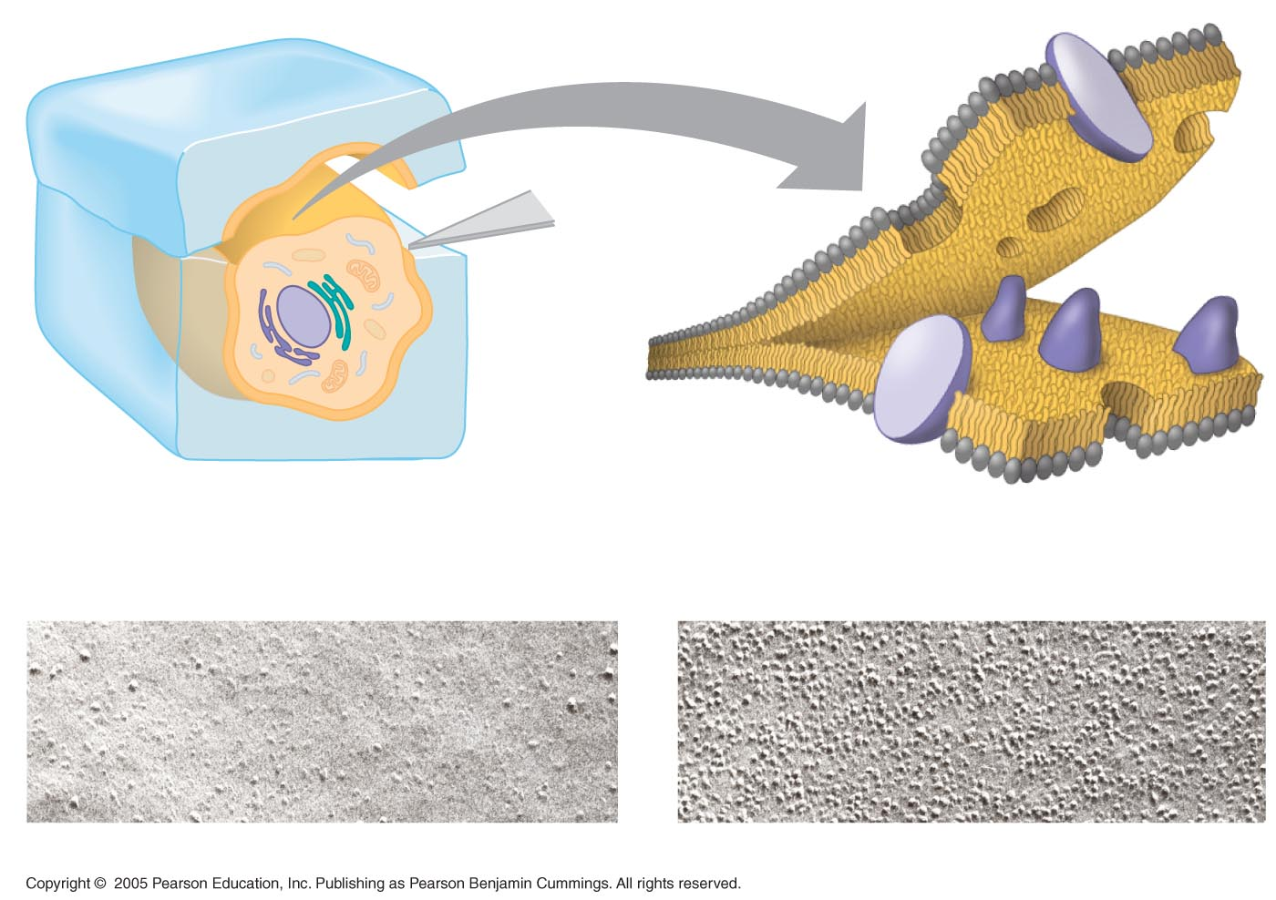
LE 7-4
Extracellular
layer
Proteins
Knife
Plasma
membrane
Cytoplasmic
layer
Extracellular layer
Cytoplasmic layer

Slide 16

Phospholipids move laterally within the bilayer
Some membrane proteins also drift laterally
Rarely does a phospholipid flip-flop transversely across the membrane
That’s why the plasma membrane is described using the fluid-mosaic model.

Slide 17
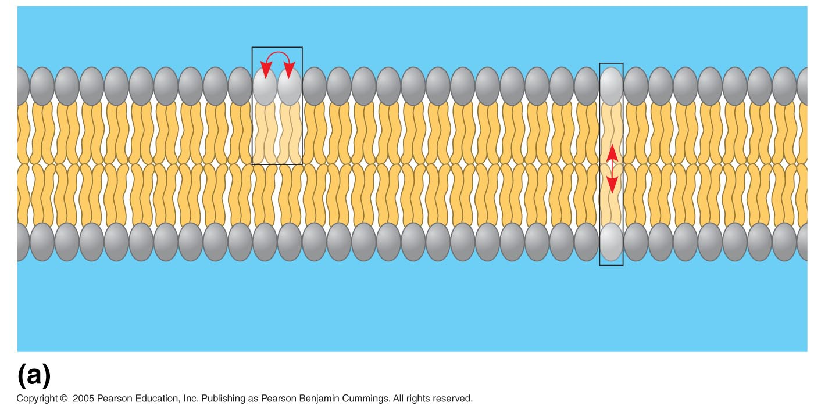
LE 7-5a
Lateral movement
(~10⁷ times per second)
Flip-flop
(~ once per month)
Movement of phospholipids

Slide 18
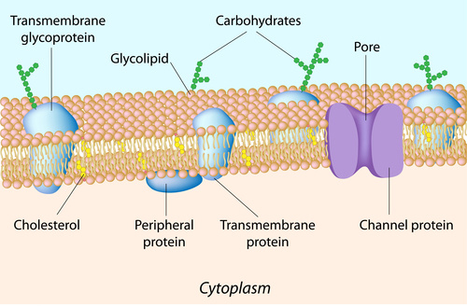
The molecules in the plasma membrane….
The cholesterol makes membrane more stable and prevents it from solidifying when body temperature is low.
Carbohydrate chains are specific to every person, and supply characteristics such as blood type.

Slide 19
Functions
Physically separate the intracellular components from the extracellular environment.
Provides a mechanical support to the cell.
Selective permeability
Facilitate transport of materials
The movement of substances can be either
"passive“ (without cellular energy), or
"active“ (requiring energy)

Slide 20
Transport mechanisms
Passive osmosis and diffusion: small molecules, ions such as CO₂ oxygen O₂
Transmembrane protein channels and transporters : Nutrients, such as sugars or amino acids
Endocytosis: cells absorb molecules by engulfing them
Exocytosis :membrane of a vesicle can be fused with the plasma membrane, extruding its contents to the surrounding medium.

Slide 21
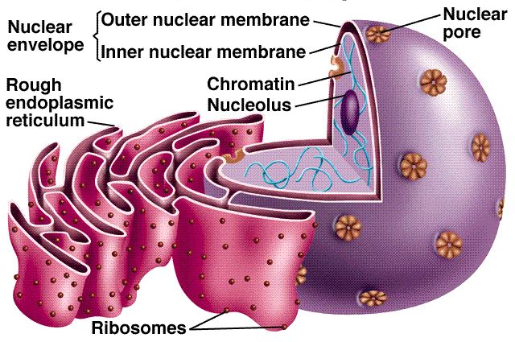
3. Nucleus

Slide 22
Membrane-enclosed organelle found in eukaryotic cells
Generally found in the central region of the cell (in animal cells)
Roughly spherically shaped
Largest and most easily seen organelle

Slide 23
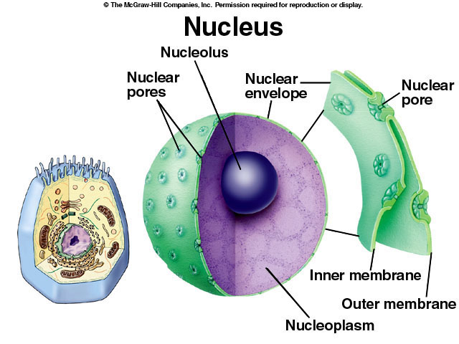
Largest structure present inside the nucleus
Dark staining zone in the center of nucleus, where intensive synthesis of ribosomal RNA takes place
Main components are RNA, DNA, and proteins

Slide 24
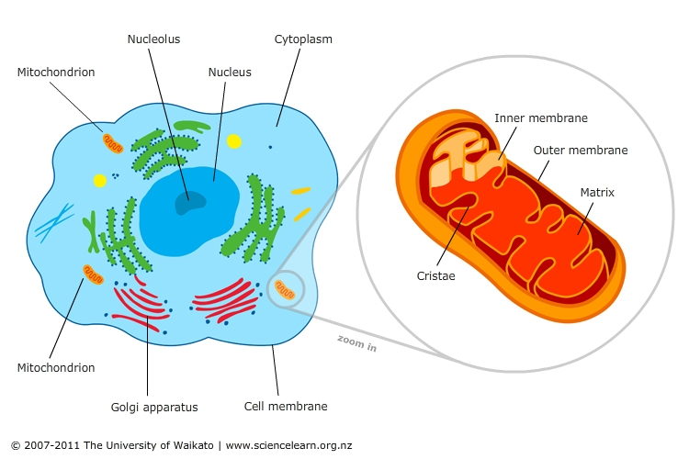
4. Mitochondria

Slide 25
Double membrane
Inner membrane is folded in to cristae
“The power house of the cell“…….generates ATP.
ATP generates through citric acid cycle, or Krebs Cycle.
Food converted into energy (ATP)
Consumes Oxygen, produces CO_{2,} water, energy

Slide 26
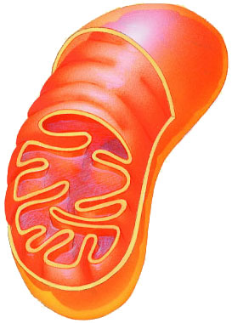
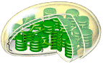
Plants make energy in two ways…….
Cellular respiration (Mitochondria)
Sugar + O₂ → ATP
Photosynthesis (Chloroplasts)
Sunlight + CO₂ → ATP + sugar
ATP = active energy
Sugar = stored energy

Slide 27
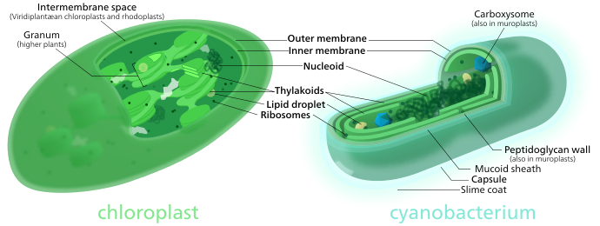
4. Chloroplast

Slide 28
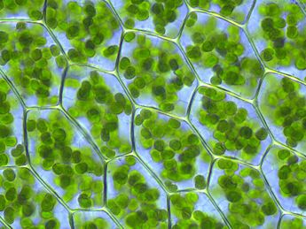
Present in plant and algal cells.
Main role is photosynthesis.
The photosynthetic pigment chlorophyll captures the energy from sunlight.
Stores energy as ATP and NADPH while freeing O₂ from water.

Slide 29
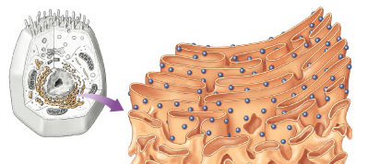
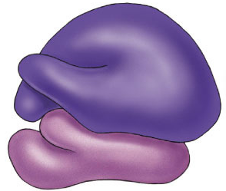
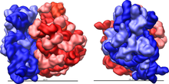
5. Ribosomes
Free in cytoplasm
Attached to ER
Protein factories
Read instructions to build proteins from DNA

Slide 30
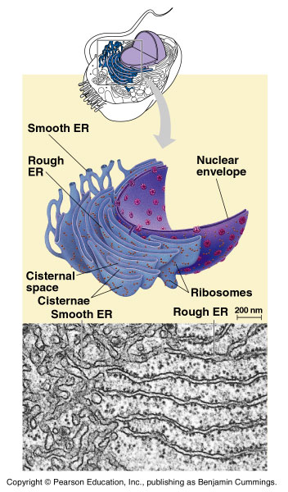
6. Endoplasmic Reticulum
Rough ER
Ribosomes attached, Helps complete the proteins after ribosome builds those
Smooth ER
Makes membranes

Slide 31
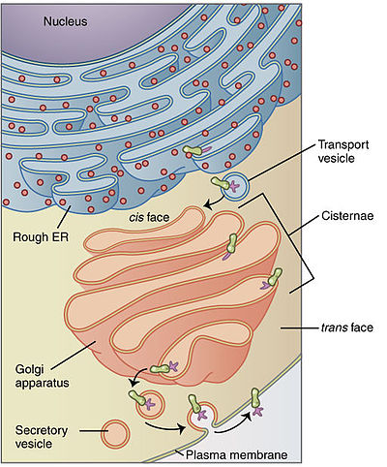
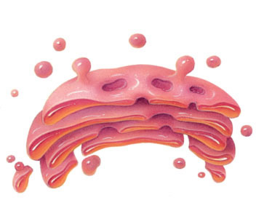
7. Golgi Apparatus
Membrane sacs
Finishes, sorts, labels & ships proteins
Ships proteins in vesicles

Slide 32
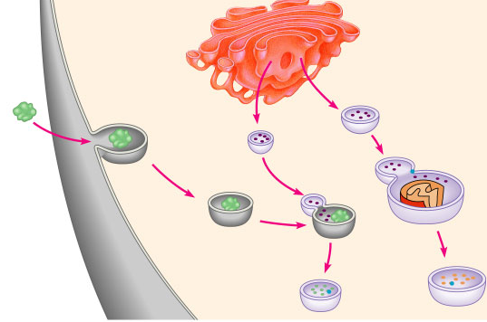
8. Lysosome
Membrane sac of digestive enzymes
Lysosomes
Small food particle
Digesting broken organelles
Vacuole
Digesting food
Function
Digest food for making energy
Clean up & recycle; digest broken organelles

Slide 33
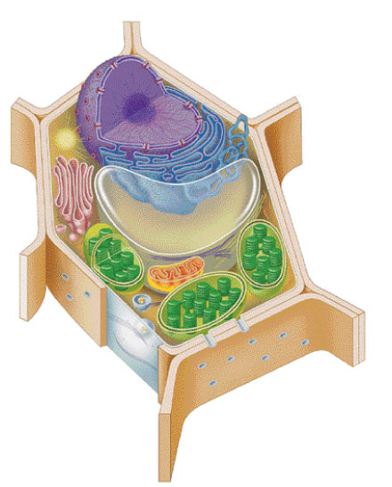
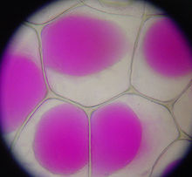
9. Vacuole
Present in all plant and fungal cells
Enclosed compartments
Filled with water, containing inorganic and organic molecules including enzymes
Vacuole

